Slide 1
Project Plan: “AMO Portal”
July 2013
NTT DATA Corporation

Slide 2
Project Summary
AMO Portal
Project overview
Develop a platform/tool that will help AMO engagements capture and expose operational data and performance metrics through dashboards and insightful analytics, replacing fragmented tool sets and inconsistencies across engagements
Project owner/Project manager
TBD
Technology Domain
Web based, Cloud, Open source leverage m2Cloud, Java, .Net,
Targeted Industry(e.g. "Manufacturing")
All AMO engagements. Initial focus on representative top 10 accounts
Expected Result/Effect
A state-of-the-art modern portal that captures data in a consistent way and allow engagements to customize it to meet specific needs. Also allow integration with a set of optimization applications that leverage and enrich operational data
Total Budget (US$): US$ 188,000
Key Deliverables
Deliverables | Details | Type of deliverables
Metrics and SLA Global Reporting | a) SLA compliance of our service teams b) Status of service requests, routine tasks and projects | Software Ready for Deployment
Optimization “app store” | a) Incident trend analysis for efficient incident resolution b) Predictive analytics for proactive incident management | Software Ready for Deployment
Portfolio Analytics | a) Capability mapping for rationalization of clients' application portfolios | Software Ready for Deployment
Notes:
Horizontal split

Slide 3
DynAMO Services, AMO Portal Landing Page
Business Alignment
Portfolio Optimization
Core Services
Transition Programs
Adaptability
Innovation
Tools
Methodology

Slide 4
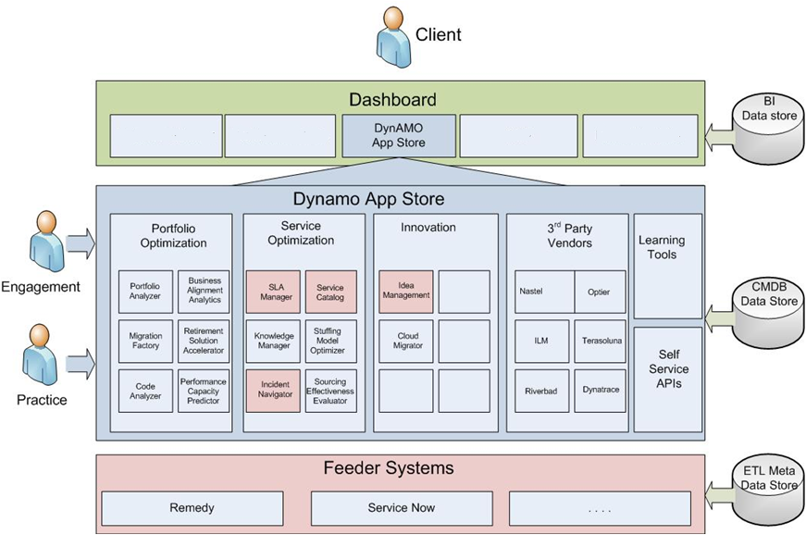
AMO Portal Client Dashboard
Adaptability
Deliver Metrics
Portfolio Analytics
Innovation

Slide 5
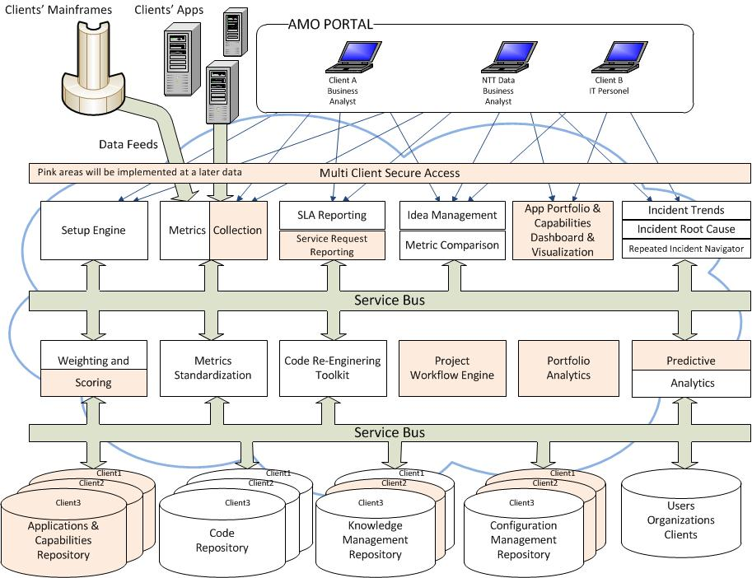
AMO Portal Architecture

Slide 6
High Level Milestones Summary….. (1/2)
July 16th 2013 | September 2013 | October 2013 | November 2013 | December 2013 | January 2014 | February 2014 | March 2014
Sprint 1 – Accelerated Requirements Gathering and Review
Sprint 2 – Accelerated Design Phase
Sprint 3 – Foundational Functionality
Sprint 4 – Functional Data Entry
Sprint 5 – Incident Functionality
Sprint 6 – SLA Functionality
Sprint 7 – Final Dashboard
Mar 7
Delivery Date
Due Date;
Acceptance Period
Mar 10th -14th
Program Management

Slide 7
Project Plan: AMO Portal GBS Innovation Fund
July 2013
NTT DATA Corporation
V1 July 2 2013

Slide 8
(Please omit notations when unnecessary)

